Slide 1
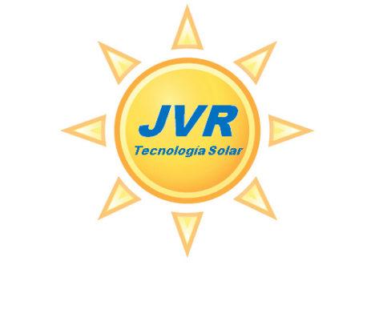
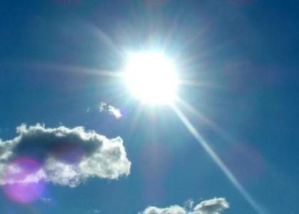
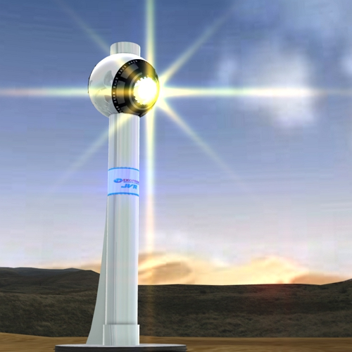
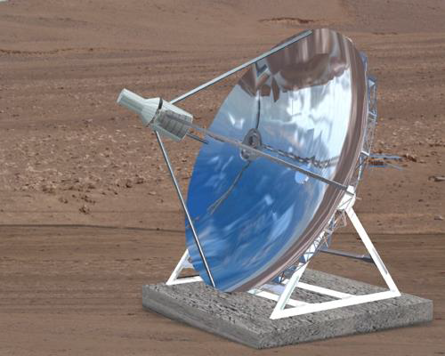
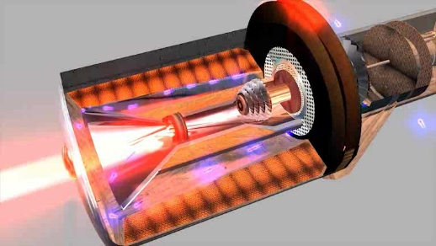
Imágenes de turbina y torre JVR realizadas por Ekoprojek.com
CONFIDENTIAL
June 2013
BUSINESS PLAN
Turbine of generation with solar power JVR

Slide 2
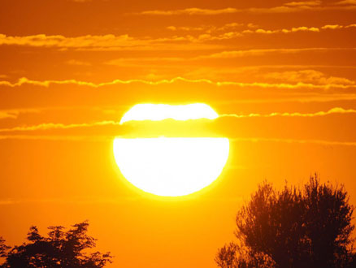

Slide 3
THE SUN
in front of us we have got the biggest energy source that the man has ever known. A star that not only provides light and warm, but also is constantly emitting hundreds of thousands of Tera Watts (Tw) that we do not take advantage of and that could solve all the energy and pollution problems that we suffer nowadays in the Earth.
The energy that we obtain from the fossil fuels of our planet, besides being finite, are just a drop of water in the ocean, compared to the one that the sun can offer.

Slide 4
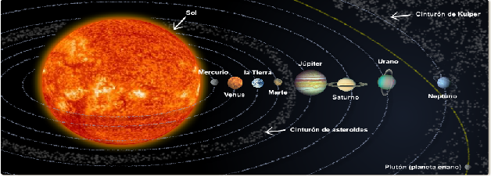
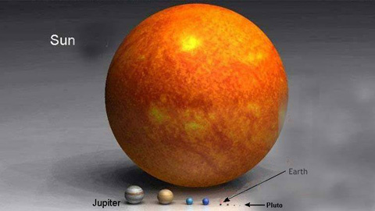
Our planet is located in a privileged and perfectm distance from the Sun, what has allowed the existence of life in the way we know it.
This star constantly invades us with massive energy emissions that we do not use properly.
Just seing its magnitude infront of the Earth, we can figure out the amount of possibilities that its possible explotation could offer us.

Slide 5

¿Why should we keep on consuming our natural resources and continue polluting the platet when we have the biggest and inexhaustible source of energy known in front of us, which is the sun?

Slide 6
The answer is very easy
1st.- Even with the efforts that are being done in the field of the use of Renewable Energy, there was not a technology effective and economical enough to turn out being rentable the use of this clean energy until now.
2nd – All the technology used in the solar power production evolves from the use of steam associated with a conventional turbine. That is to say, the same technology developed in 1804, applied to the fabricaton of the first steam locomotive.

Slide 7
THE TECHNOLOGY NOWADAYS
Nowadays, for the production of energy through the use of sunbeams, there are only two active technologies: a) The one that uses photovoltaic panels, and b) The one that uses thermal collectors. Both of them presents technical difficulties:
. Photovoltaics. In its current state, it faces important technological difficulties. Its production losses, close to a 9%yearly, raises important limits if it is not associated to important grants and subsides, circumstances that can not be assured invariable and permanent in the near future.
. Thermal energy. Its operation is associated to the water availability for the production of the steam that will move the turbines. It is a relatively expensive technology, and it consumes water, a source that is not always availableand assured in areas of high insolation.

Slide 8
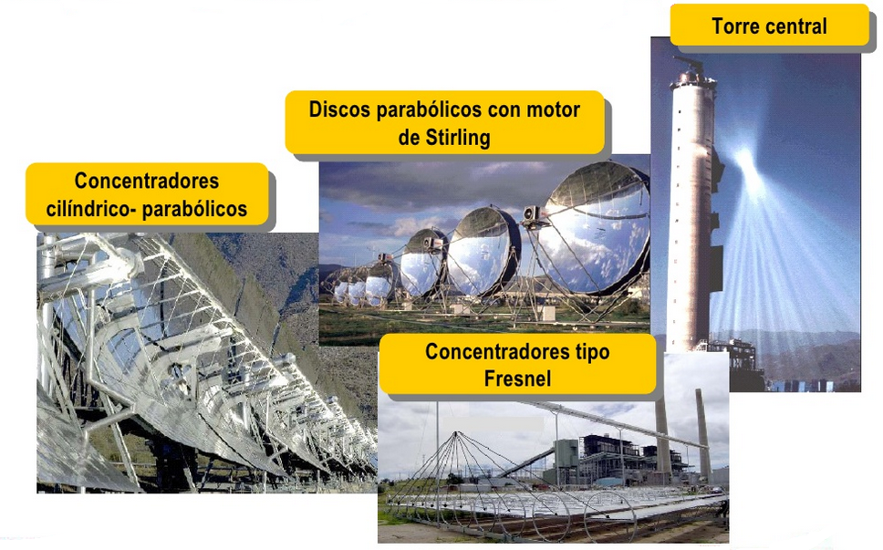
MAIN SOLAR THERMAL TECHNOLOGIES

Slide 9

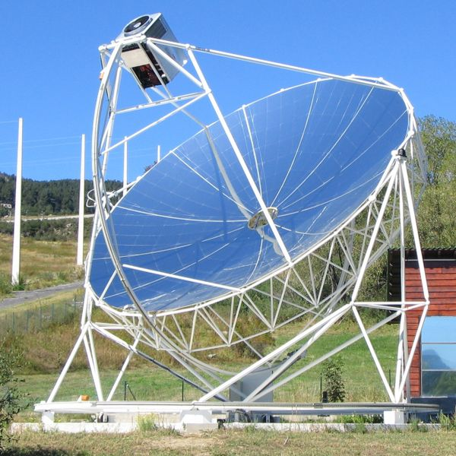
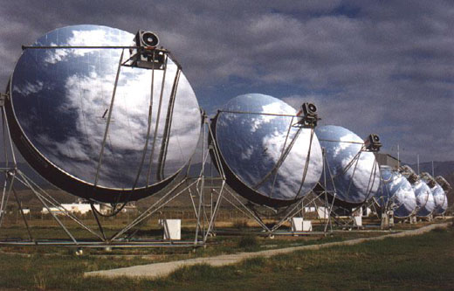
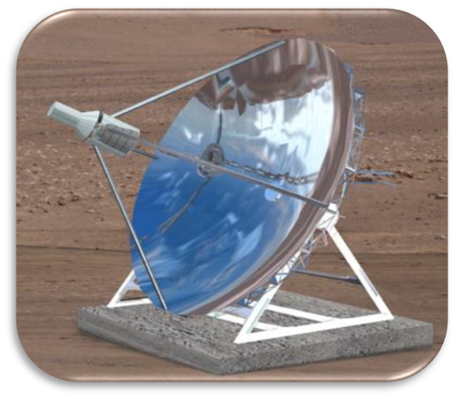
COMPETENCE
Motor Stirling
Turbina JVR
 | Potency/ power | Temperature | Price | Cogeneración mediante acumulador (+20%)
Parable + Stirling engine | 3,5 Kw/h | 800 C° | 18.900 € | X
Parable +JVR turbina | 15 Kw/h | 1.150 C° | 25.000 €
The Stirling motor(1.816), as the movement through the steam generation (1.804) are evolutions of technologies that already existed many years ago.

Slide 10

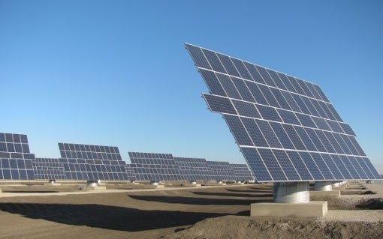
Photovoltaic plant with azimuth followers of two axes in Valladolid:
Cost → 5 mill. €
Production → 1 Mw/h
Location → Castilla y León

Slide 11
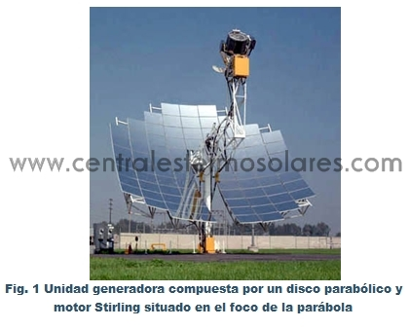
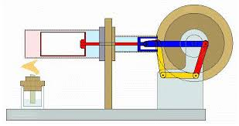
Motor Stirling: excessive size and price for the low power generation that it offers : + - 300.000€: 35 kw
Stirling (year 1800)

Slide 12

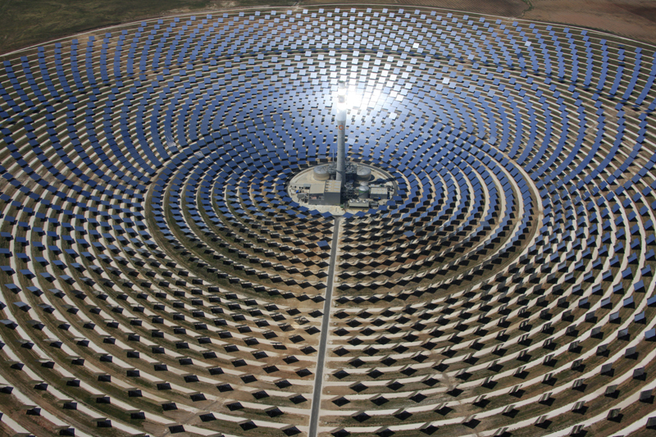
Thermosolar GEMASOLAR plant:
Cost → 315 mill. €
Production → 20 Mw/h
Location → Andalucía

Slide 13
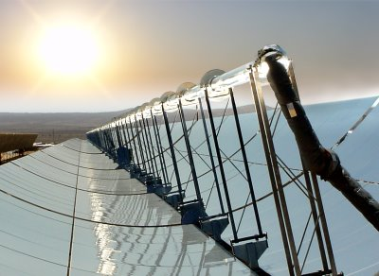
The thermal energy collectors through to cilindricoparabólicos
This technology is based on the capture of the solar radiation through a half cylinders that reflect and concentrete it in a point in which they flow. They can also use salts or a gel that accumulates the heat to use it later in the steam production. This steam is used to move a turbine that generates electricity. It is the basic idea of the the traditional Thermal Energy, but more developed and advanced.
Ubicación → Andalucía
Almería

Slide 14
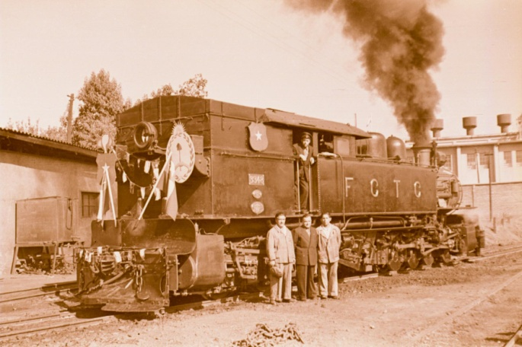
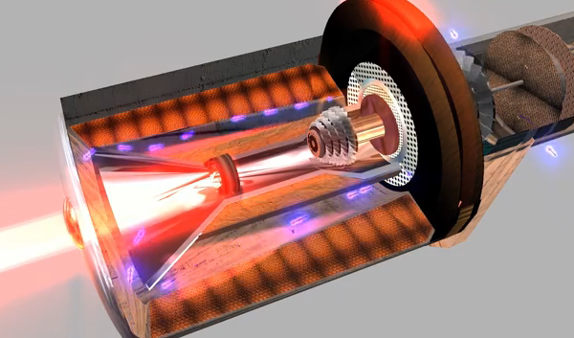
CONCLUTION OF THE PRESENT TECHNOLOGY
The present reallity reflects that whith the technologies that are being used, there is still a long way untill they are economically viable. Their costs are really high compared with the power produced.
Cientifics and engineers have been trying to achieve a better result to the ones found with the technology applied to the steam locomotive.
After lots of studies and projects we have achieved an aconomic, clean and no water-using energy production with the Solar Turbine and the Solar collector JVR.
Past = Steam
Future = Turbine solar JVR

Slide 15
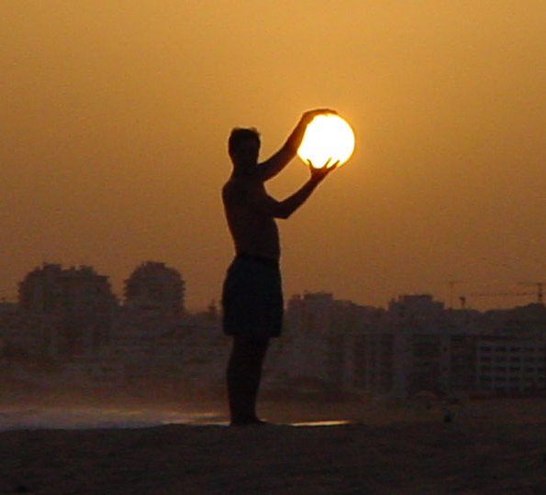
The problem is that untill now, we have been able to use few of this available energy, and this few was under very high costs. The cintific investigations have been based, untill now, in developingone unic concept: steam production using the solar energy to move a turbine and generate energy.
¿AND IF WE WERE NOW ABLE TO TAKE ALL THIS ENERGY WITH OUR HANDS AND USE IT IN THE MOST EFFICIENT WAY KNOWN UNTILL NOW?

Slide 16
SOLAR TURBINE
SOLAR POWER PRODUCTION

Slide 17
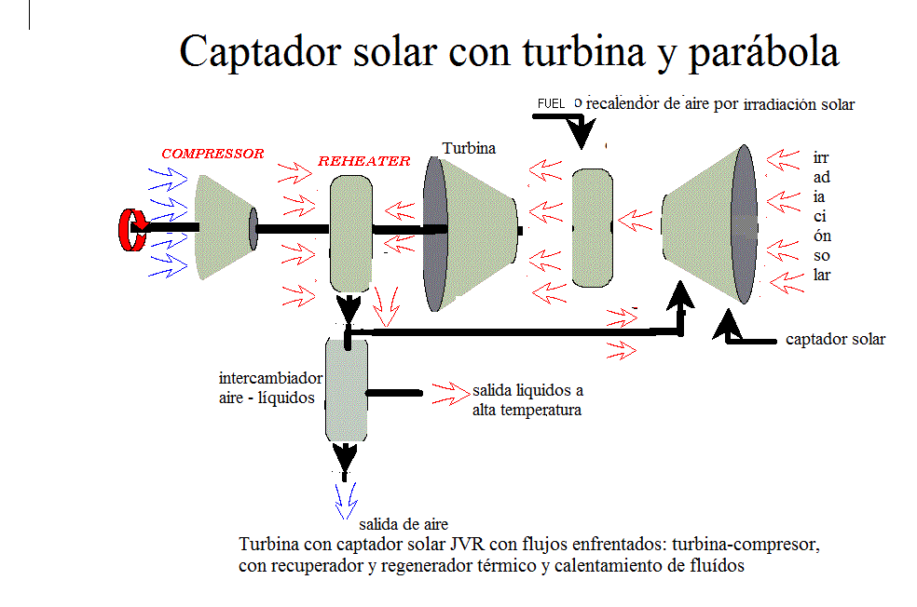

Slide 18
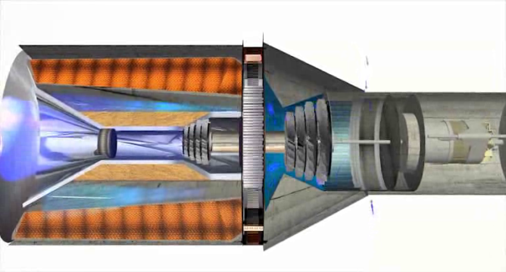
THE JVR TURBINE
A turbine that does not need water nor steam to work.

Slide 19
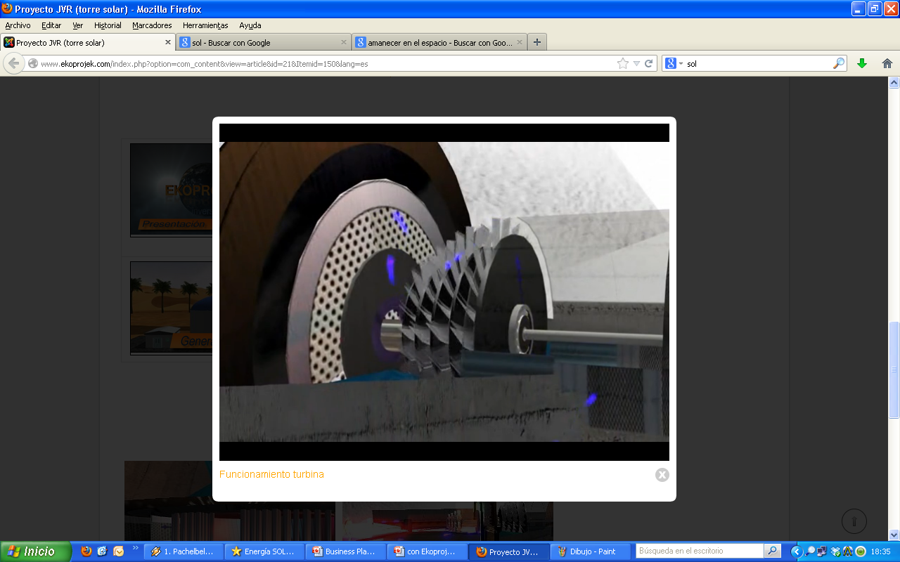
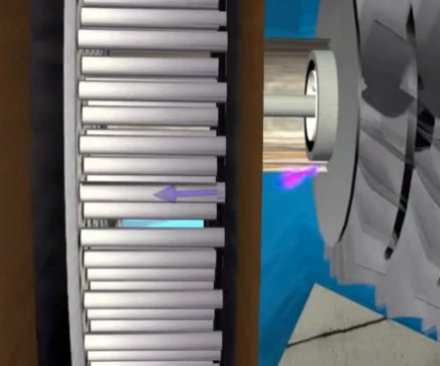
¿HOW DOES IT WORK?
Once the system is iniciated, through an electric system the first time, the compressor and the turbine begin to spin. The compressor compresses the air, quickly encreasing its temperature and leads it into a closed central wall, so it is forced to run into some micro tubes (A face of the exchanger). There from, the air reaches the sensor that recives the sun’s rays.

Slide 20

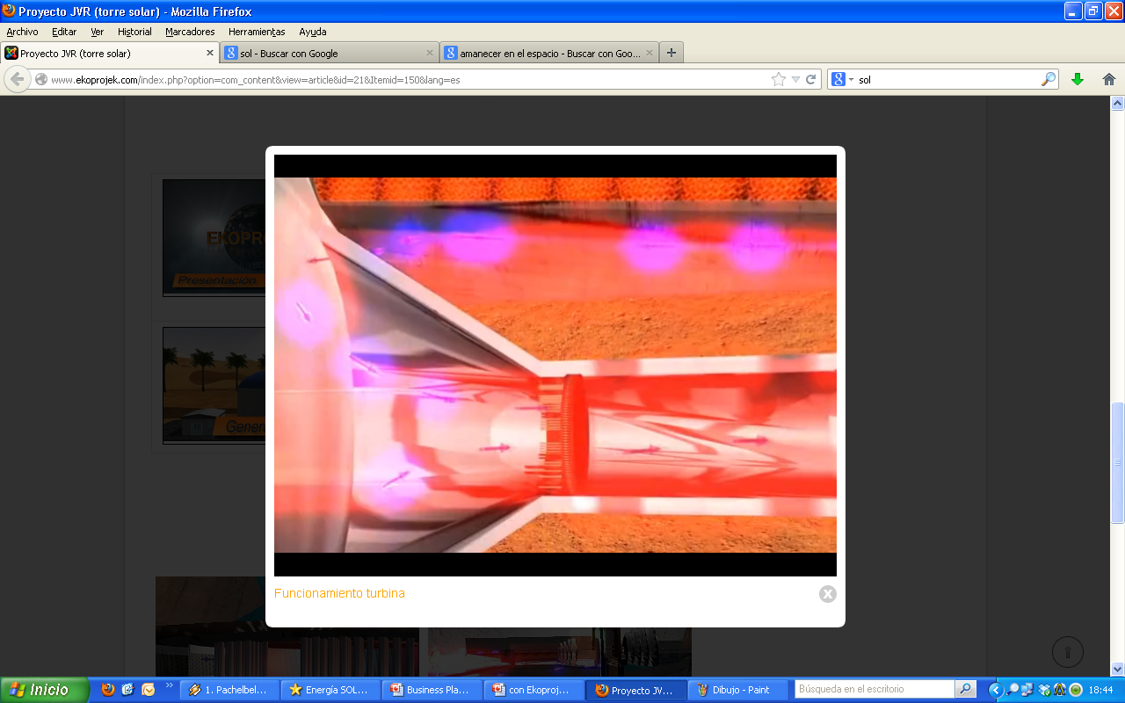
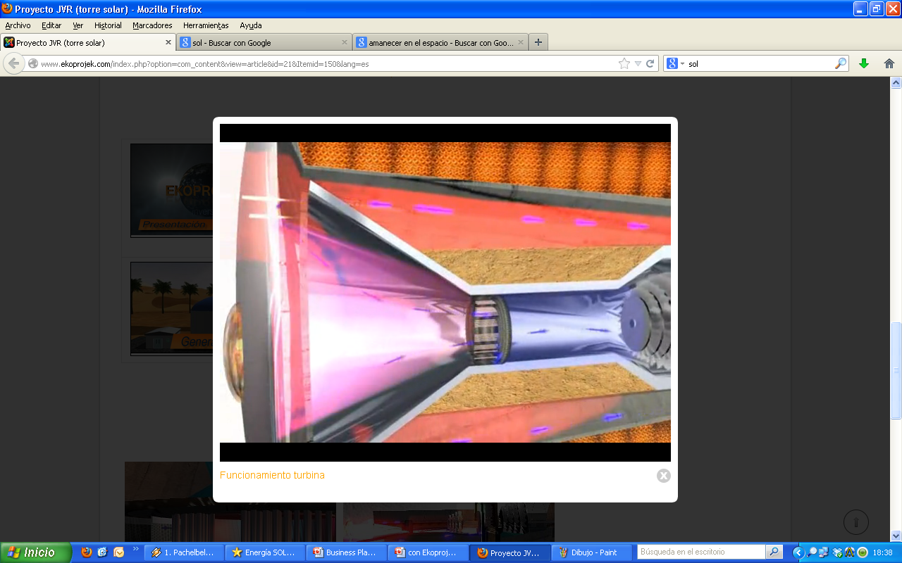
Once in the sensor, the sun’s rays warm up its walls, transmitting the said heat to the air from the compressor and the exchanger.
The air begins to overheat. Passing into the encoder, at its center is a Fresnel lens, responsible for receiving and concentrating the sun's rays to guide them to a new component, specifically designed for this turbine, which receives the sun's rays concentrated by lens, to continue lifting it at higher temperatures.

Slide 21
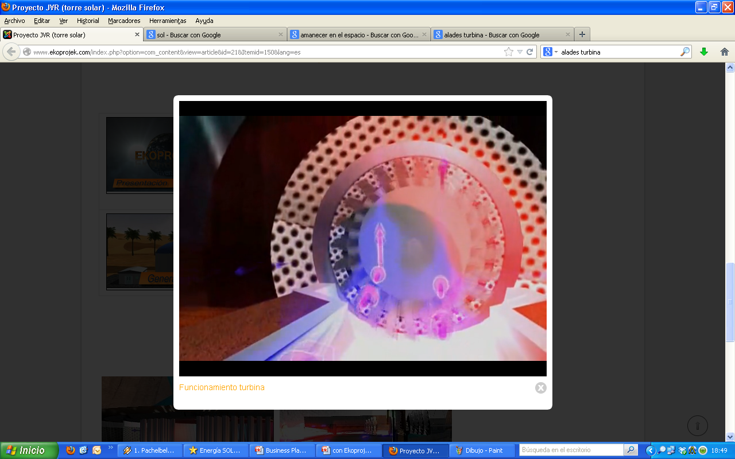
Passing through this part, the air expands and pushes the turbine blades rotating it. The thermal force is transformed into kinetic energy.
Completed the first cycle current is no longer applied to the generator acting as startup and begins to generate electricity independently without external energy consumption.

Slide 22
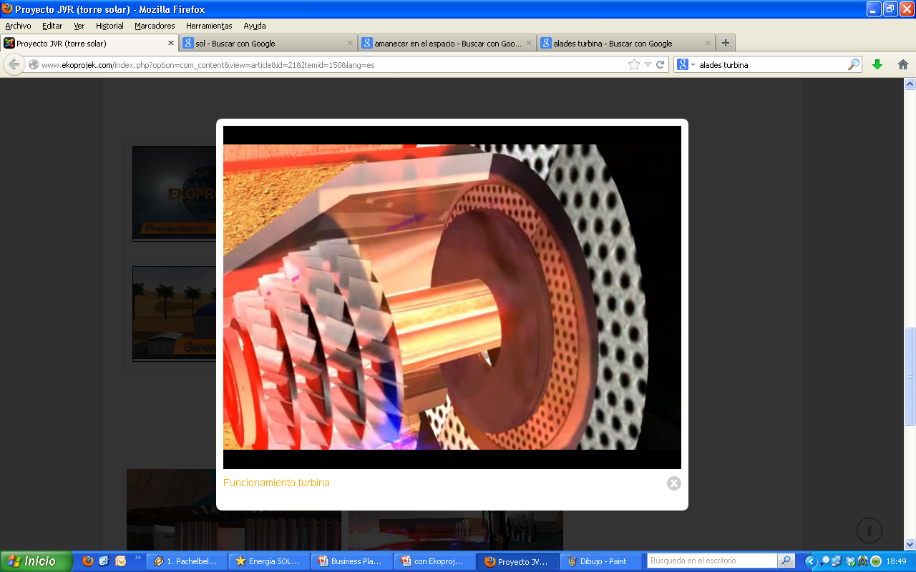
The air, at very high temperature, moves towards the exit, and the only place where it can do this is by the B-side of the exchanger. This step occurs at a high speed, with a temperature that is increased in contact with the side A and the walls of the same, where it is compressed by the compressor.

Slide 23
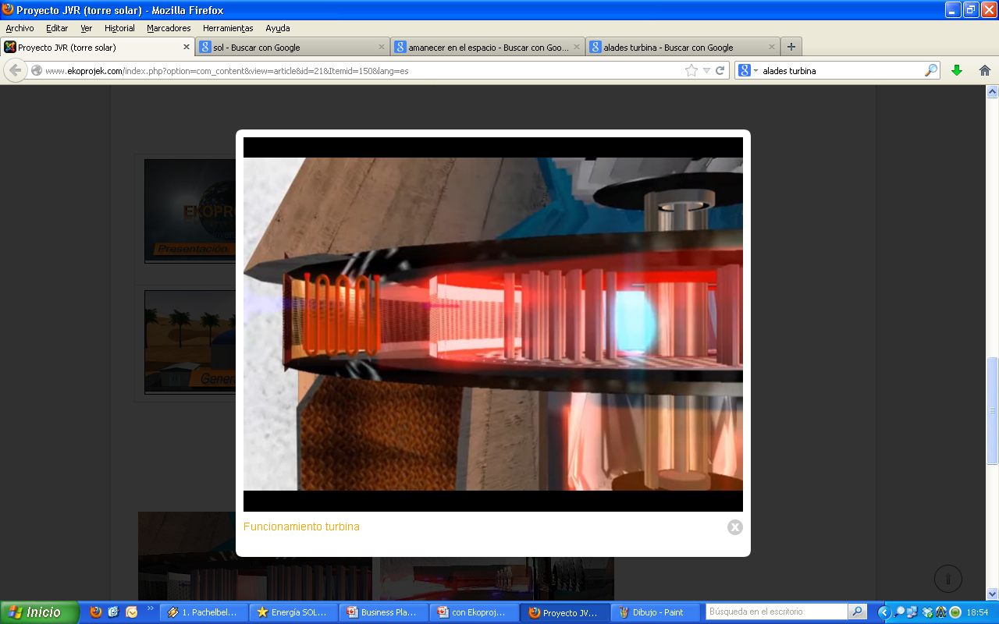
When the hot air is inside the exchanger, it is forced to pass between the tubes provides a high temperature. On his way out he meets a heat air-water exchanger. This can be useful, among other uses, to heat water for consumptive use in homes or to provide the excess heat for oils for energy storage.

Slide 24
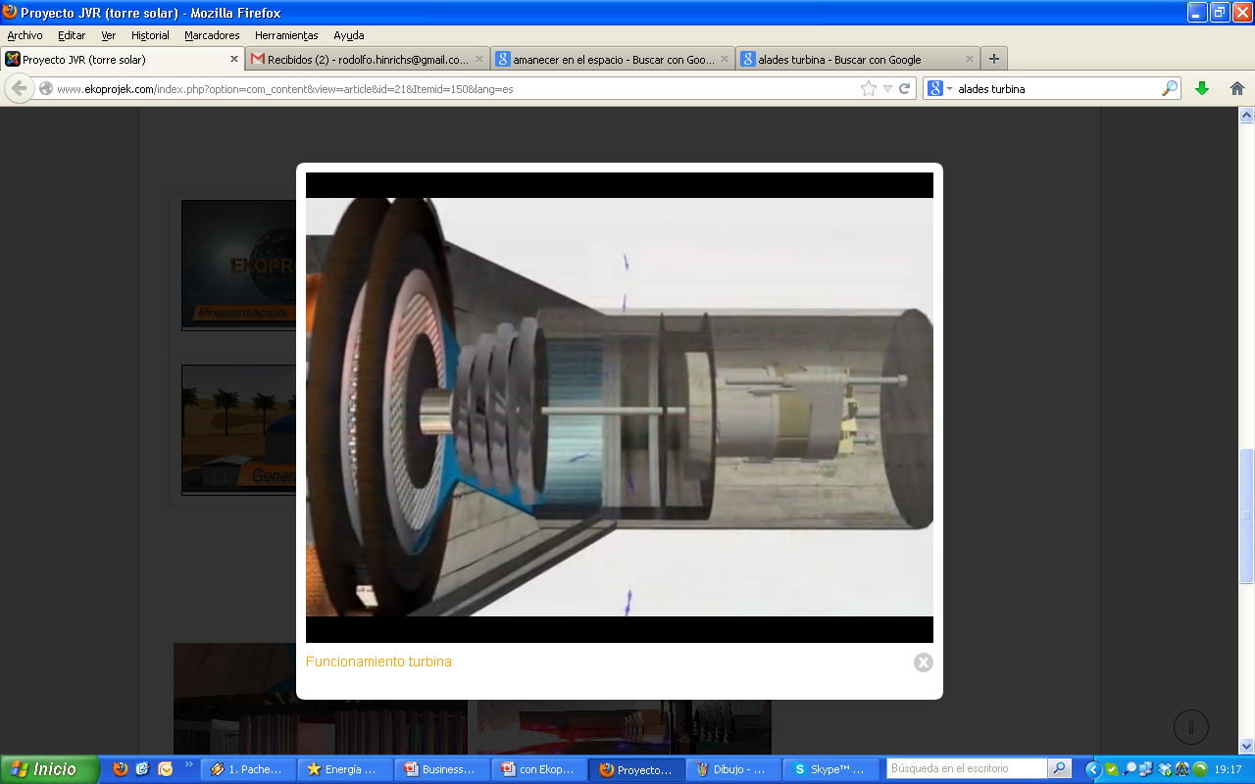
When started for the first time, as it repeats a thermal cycle, there is no need for external electricity in the alternator. The turbine is self-sufficient with the solar energy received and it starts producing electricity.

Slide 25
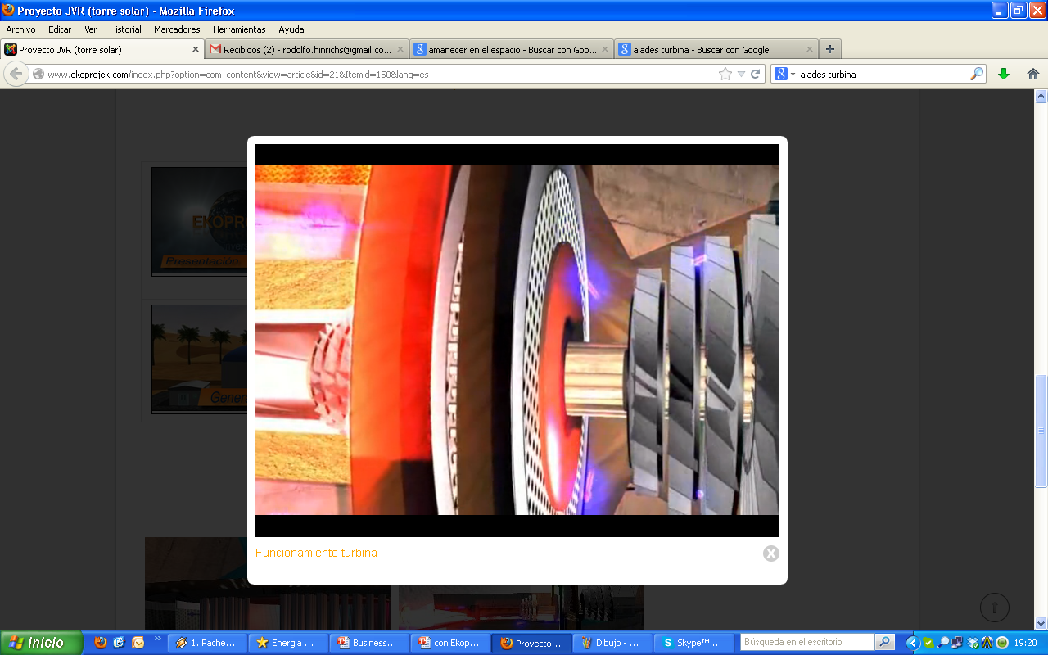
From that moment, the air expands and transmits kinetic energy to the motor turbine already on and throws it to the A side of the drum. The air, already hot, continue on taking temperature and the cycle begins again at a rate regulated by a heat and pressure sensors.

Slide 26
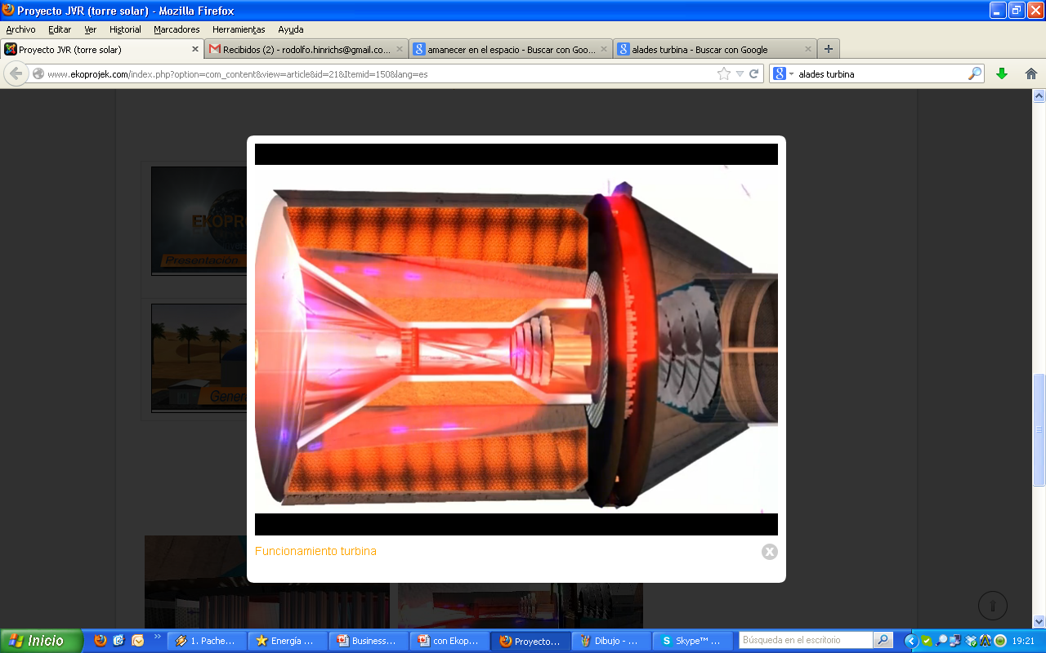
This is repeated again and again, reaching the required uniformity of the air temperature in the process.
We are talking about 85 cycles per second and the process will be continuous while the sunlight is received. If it is missing, output is controlled automatically by a computerized system that injects fuel allowing a stable production 24 hours a day, if it becomes necessary or desirable.

Slide 27


MAINTENANCE
The components and materials with which the JVR turbine is created, are high quality and high resistance. All mechanical and movable parts are:
High engineering
High resistance to expansion and high temperatures
High thermal and cooling conductivity.
That is why there will only require two annual reviews.

Slide 28
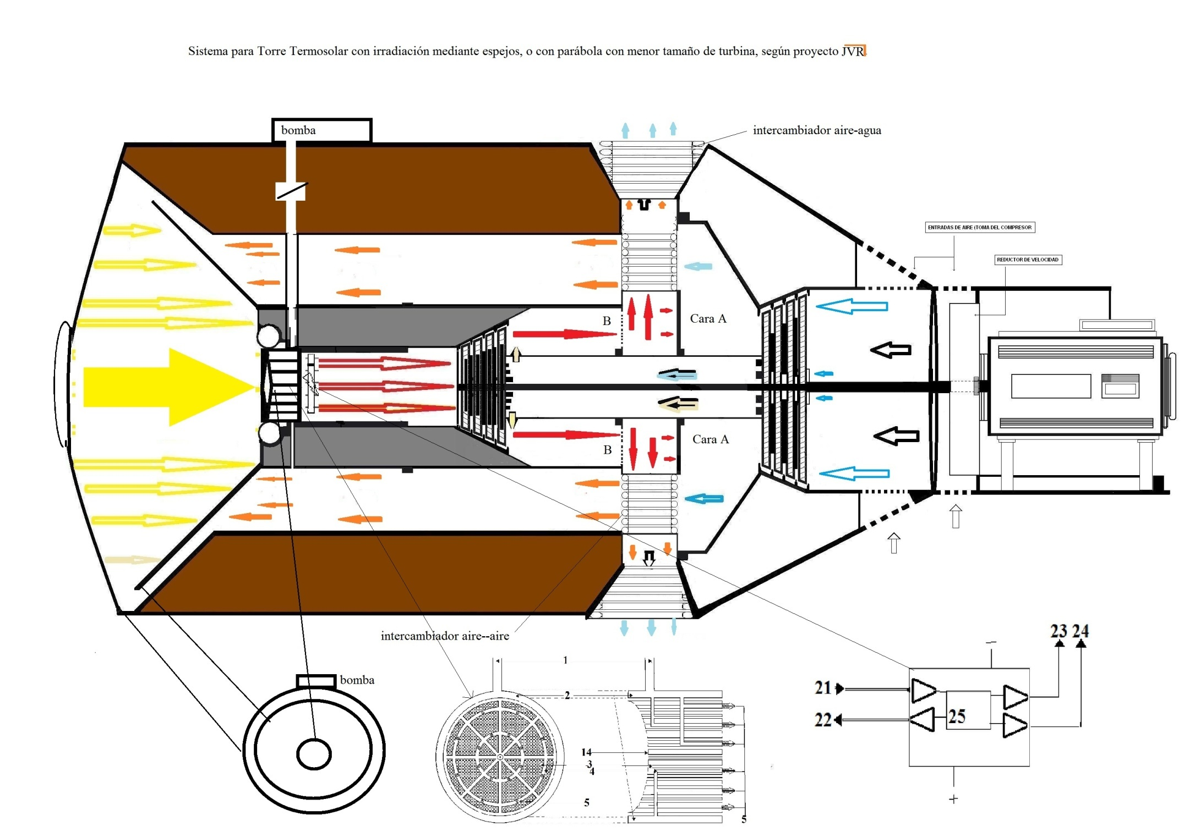
JVR’s turbine simple diagram

Slide 29
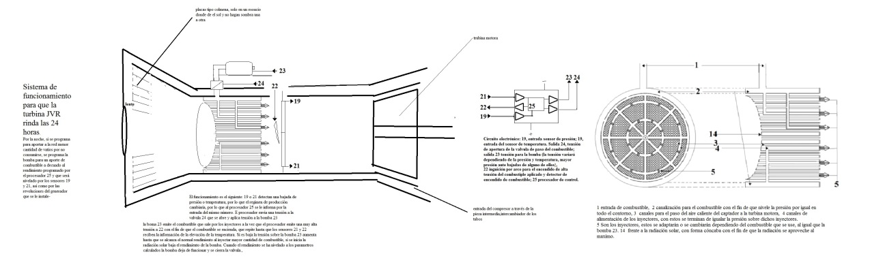
System to reheat the air and inject fuel in hours without sun

Slide 30
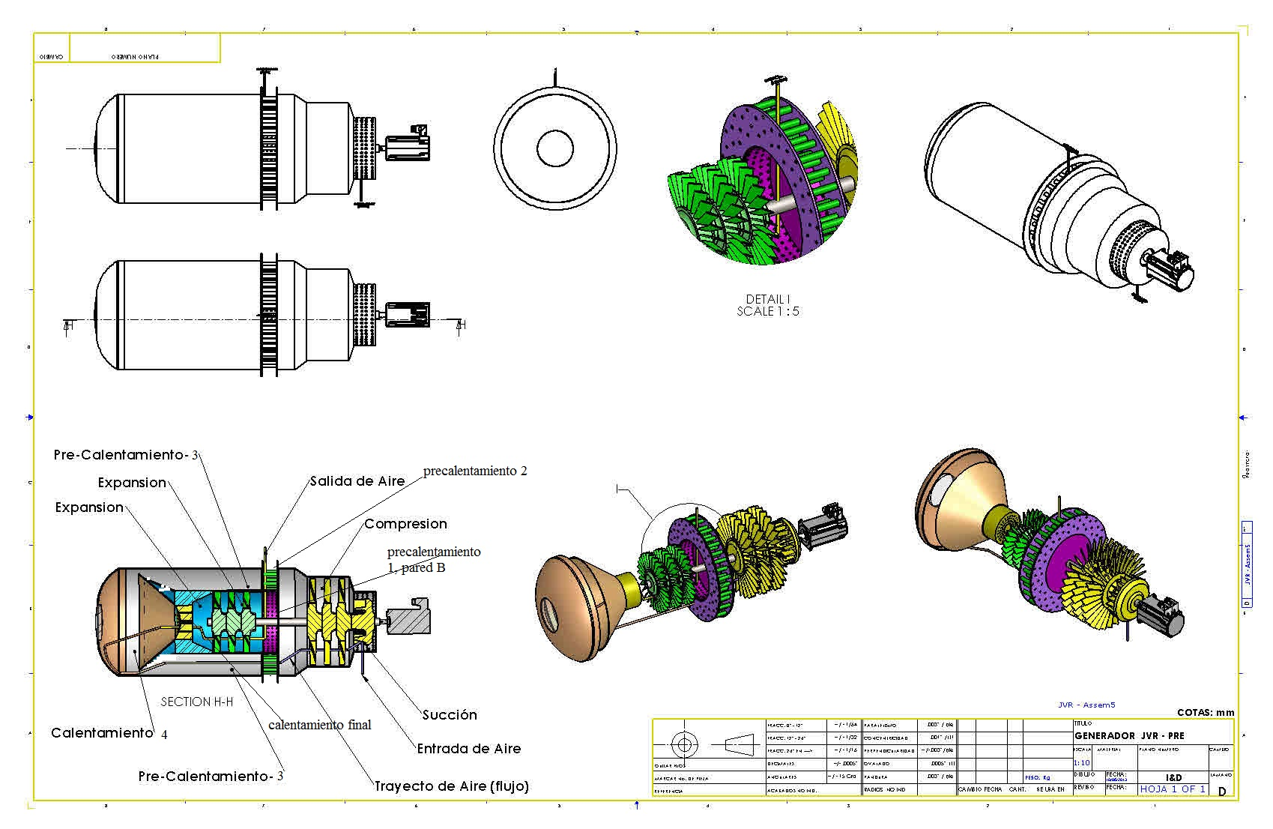
Inicio, borrador, del proyecto de Ingeniería de detalle
Por Don Guillermo Gonzalez para Jonás Villarrubia (JVR)

Slide 31
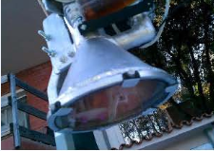
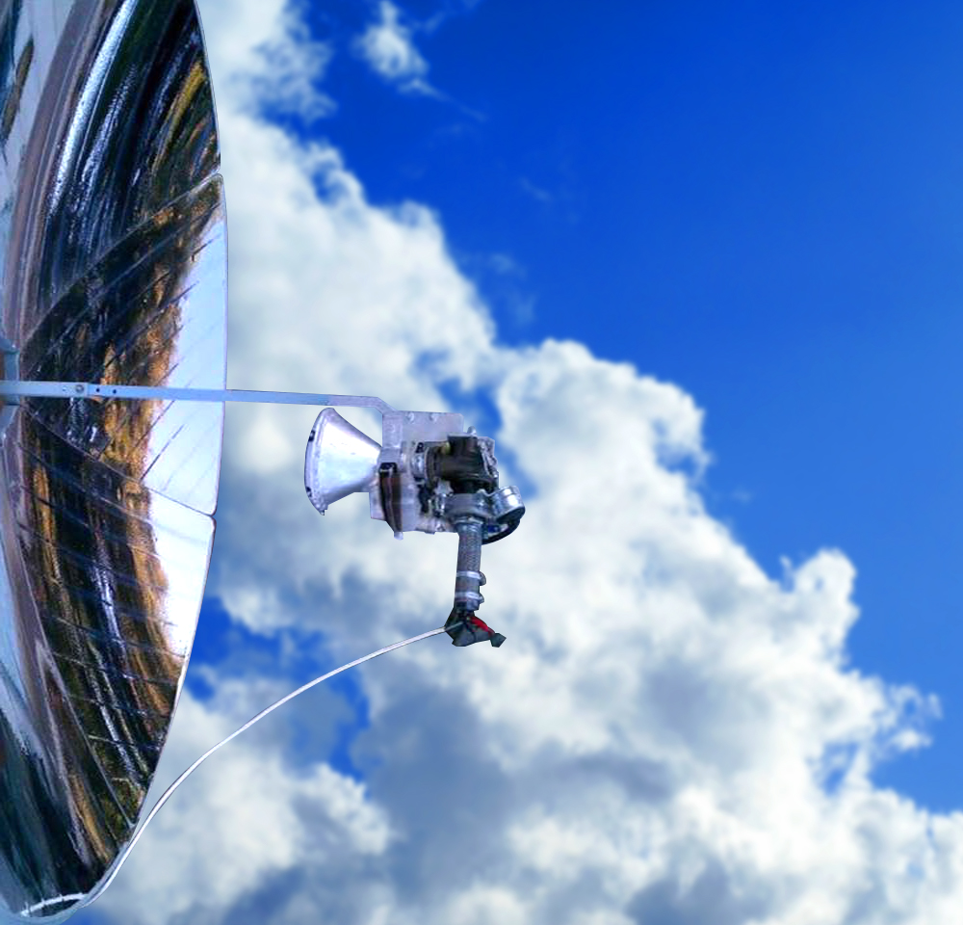
First JVR prototype works
First prototype made ​​with a turbocharger to pay for solar radiation

Slide 32
PATENTS
1. Heliostats. Protected by international PCT/ES2011/070811
published on 30/05/2013 and registered on the national stage in various countries
2. Turbine. Protected by international PCT/ES2011/070876
published on 16/05/2013 and registered on the national stage in several countries and pending in others.
3. Receiver with Injector. Protected and granted in Spain and under that
priority protected by international PCT/ES2013/070384.
4.- System to get water from air humidity, protected and patented
with international PCT/ES2011/070231, Independently
5. Pending patents
a) Hydrogen generation
b) Waste treatment.

Slide 33
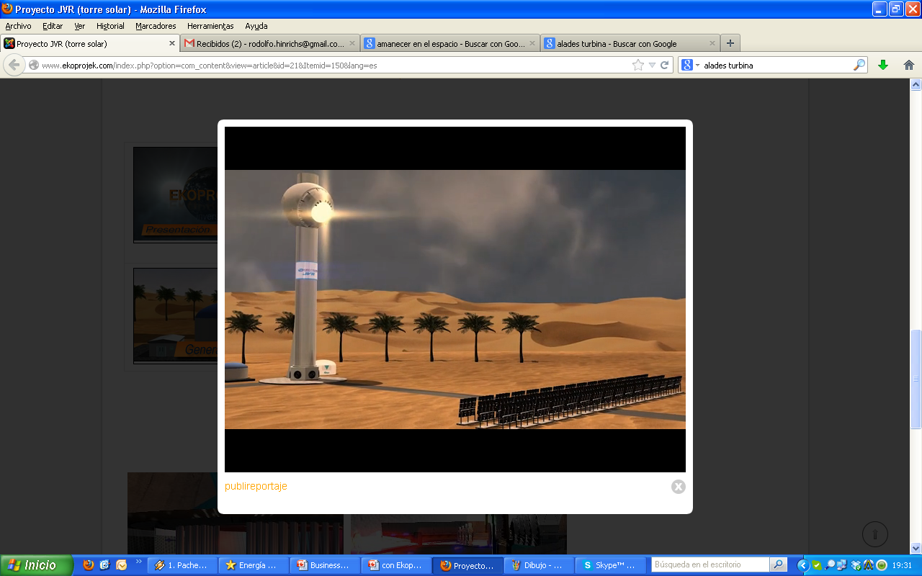
TURBINE APPLICATIONS
To find the higher effective in generating electricity, JVR solar turbine is to be implemented in two systems:
Solar Tower Solar Parable

Slide 34
SOLAR TOWER
This tower is different from the towers installed nowadays around the world in that its cost is vastly lower (up to 10 times less) and is composed by:
Support structure for JVR Turbine
Heliostats’ line
Fuel tank to ensure production 24 h/day
Tank for the generated water.
TO 20 Mw

Slide 35
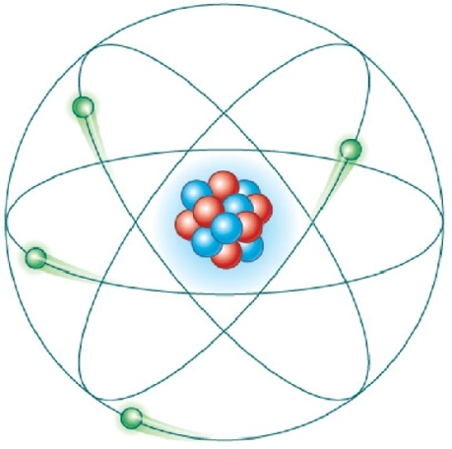
Tower characteristics
Producción entre 1 Mw/h → 20 Mw/h
Solar Tower with JVR turbine can reach an energy generation power of up to 20 MW / h with significantly lower installation cost than the alternative systems.
This ability will depend on the size of the turbine installed in the tower and the number of heliostats or mirror.

Slide 36
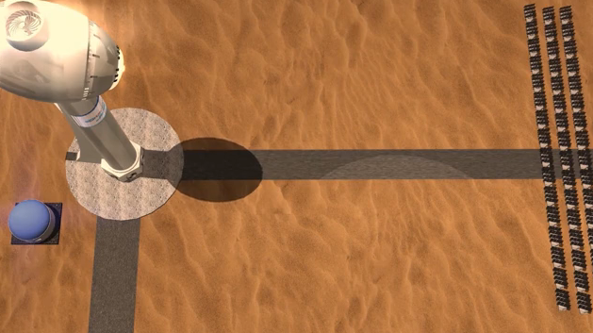
It takes up less area
The tower destinated tu produce up to 20Mw/h power with the JVR turbine, does not need as much area as the alternative technologie towers. Fot this, it has productivity associated to the heliostats specially patented and designed for this reason. These heliostats take up a tract of land considerably lower than what we currently know. (aprox. 40% less).
Conventional Tower
Tower with JVR heliostats

Slide 37
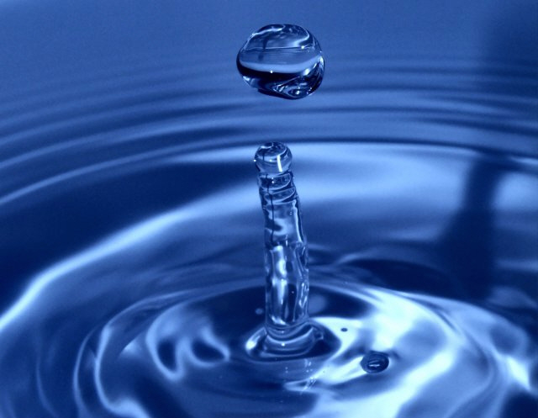
No water consume
Water is generally a very scarce resource in areas that recive a large amount of radiation and are suitable for the installation of this kind of infrastructures. This is the reason why conventional installations, large water consumers, face the problem of ensuring the access where there is a resource limitation, competing against the population and agriculture that demands it .

Slide 38
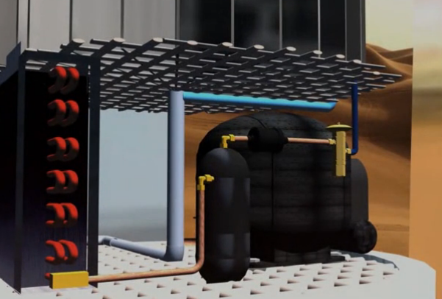
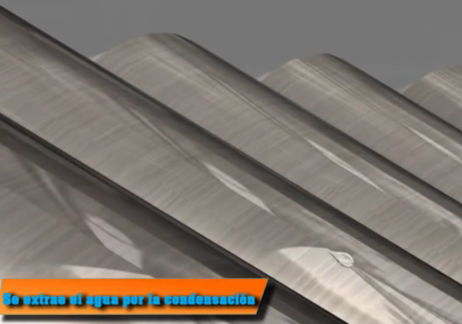
It produces water
The JVR solar tower, while it produces energy through a unique and patented system in the energy solar towers, it also produces water. The residual heat and a new system of evaporation, allow an efficient condensation effect, extracting WATER from the relative humidity of the air.
Produced water can accumulate in nearby deposits.
In order to be used for human consumption, it needs to be supplemented with a simple process of mineralization.
.

Slide 39
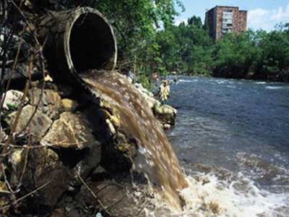
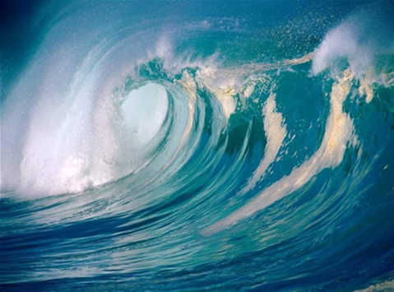
Purifies and desalinates water
The JVR yower produces energy and at the same time its generation process can be used to purify dirty waters that do not contain excessive solid waste and for its desalination.
This raises the possibility of dual use in countries where fresh water is scarce, but have access to the sea or rivers of non-potable water and where desalination plants are being installed at a cost of millions of euros and with the aggravating of containing high boron ratios.
All water intended for human consumption treted with JVR technology, must be passed by/through a mineralization process, as it comes distilled.

Slide 40
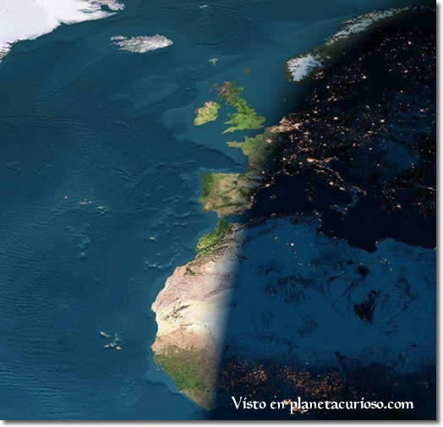
24 hours production
Zero pollution and enviromental impact
JVR turbine enables the production of energy in combined cycle, sun – fuel, and can have high performance at a low cost 24 hours. To do this, during times when there is no sun, gaseous fuel can be used (natural gas, hydrogen, etc..) To cause heating of the air. The unique design of the JVR turbine makes the temperature increase be exponential and with a high utilization of the residual. It allows, with low traditional fuel, the obtaining of high temperatures and a high “par” in the rotation of the turbine.

Slide 41
Para 29, 354MW/h
Compression ratio turbine...1/18
Air flow... 68 Kgrs / sg
Inlet temperature air...290 K°
Temperature inside... 1,127 °
Temperature air exhaust turbine... 704°
Gross horsepower turbine... 47.821. 35 KW/h
Power delivered to the compressor... 28.300 KW/h8
(Superheated steam production)... 32.989 Kg/h
(Pressure steam)... 40 Kgrs /cm²...
Overheating temperature 823° K
Enthalpy steam reheating......850 Kcal. /Kgrs
Enthalpy in the download...-600 Kcal. /Kgrs 5
Pressure discharge (condensing vapour-air mixture)...0,2 kg / cm²
Title saturated steam (download)... x = 0.95
Obtained power:... (850-600) / 860 x 32989 Kgrs = 9.833 KW/h
By attaching to compressor turbine:...28300 Kw-9833 Kw = 18.467 Kw net Power delivered to the generator...47 821 Kw-18467 Kw. = 29354 Kw / h 10 Thermal energy received at sensor.........51.428 Kw. / h
Performance of the cycle after the sensor...57%
Surface of heliostats (performance capture: 60%)...85.713 m2
For a radiation of 1000w/m2.día.h
Performance of the complete cycle turbine has gone up to 57%)

Slide 42
Parables characteristics
Up to 15 Kw
The solar parable or parabolic solar collecto, bases its technology on the concentration of the sun's rays on the sensor lens installed in front of a new/newfangles module, achieving this way high temperatures in the fluid that feeds the JVR turbine.
The maintenance required for this type of equipement with JVR technology is lower than the expected for traditional turbines.

Slide 44
Parables characteristics
Produces energy
Among 1 Kw/h → 15 Kw/h
The Solar Parable with JVR turbine can reach a power generation capacity of up to 15 Kw / h, with a much lower cost than the alternatives available in the market. This capacity will depend on the size of the parabola and the turbine that accompanies every installation, as well as solar radiation of the place.

Slide 45
Production installation
The installation of a JVR turbine in a concentration parabolic system is designed to:
1. Instalaciones unitarias in homes or buildings.
2. Major production faciliti/installations.
Possibility of line Parables and connected in parallel to achieve the desired power, even in areas with no previous water prevision assured. If no water is needed, parables use is the most convenient option from the economic point of view.

Slide 46

PRODUCT:
JVR Paraboloc Solar Concentrator
Components:
High Reflectivity Parabolic Concentrator.
2. Receiver with Solar Collector of cavity.
3. Generador solar turbo comprimido (compressor and JVR solar turbine)
4. Regenerador de la térmica con un sistema de intercambiador nuevo
5. Sistema de seguimiento (2 axis).
6. Battery or connection to rectified net. (just to start).
7. 15 kwh units at a cost of 0,047€ per kw produced ( 0.749 $)
8. On tower, it produces water of the relative humidity of water (no hauria de ser “air”?) (accessory)

Slide 47


SOCIAL IMPACT
The low cost of installation of parabolic systems allows its acquisition by anyone interested. Most will stop paying high electricity prices, both in their homes and in their businesses.
It will also facilitate the generation of many jobs, both direct and indirect.

Slide 48

ECONOMIC IMPACT
The investment is recovered between/Among the second and third year.
The cost of electrical energy is practically reduced to “zero” in every home and economic activities, especially in cases without a network connection.
The potential savings in business, professional activities and services, will allow these resources to various alternative purposes.
Energy, watt generated, applied to the net, is highly profitable, without need of any subsidies.

Slide 49

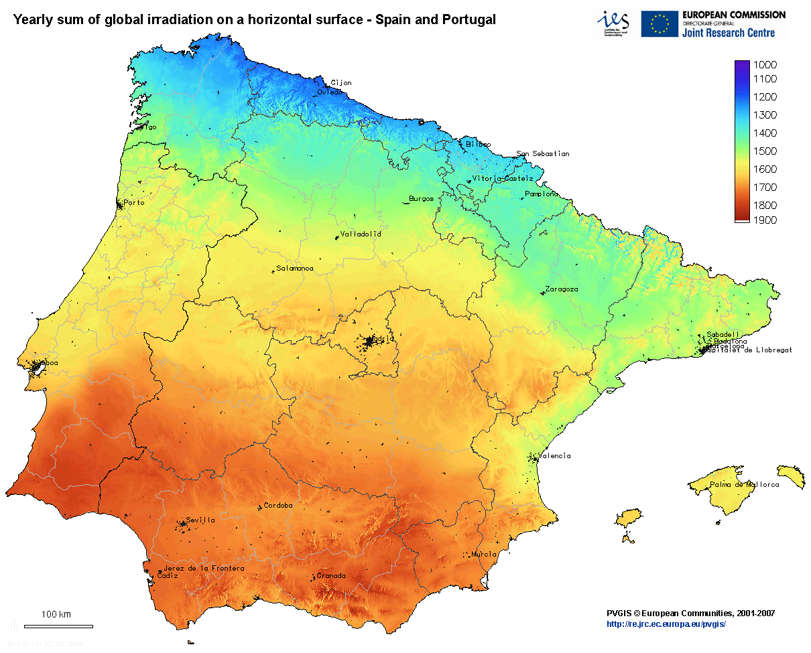
SPAIN

Slide 50

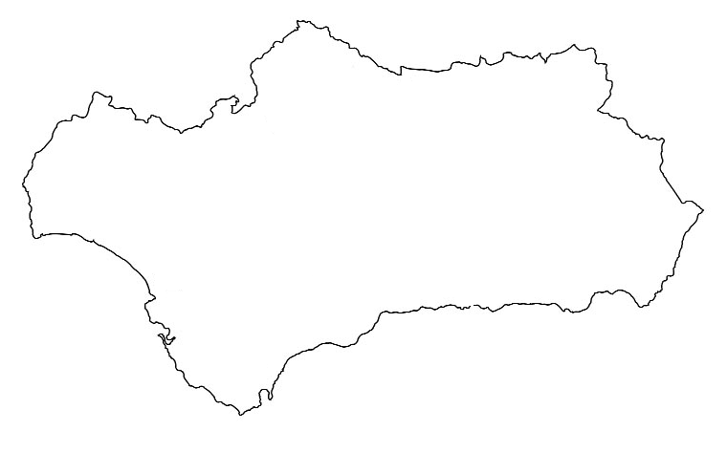
Andalcía has shown on its climatological history to be the region of Spain with more hours of sunshine a year, with 3.000 hours, according to the INE. This potential is already being used by energy companies but with a much lower efficiency
and at higher cost than with the
JVR technology.

Slide 51
LEGISLATION AND PRICES
The geographic situation of the Iberian Peninsula on the planet and taking into account the inclination of penetration of the sun's rays and the radiation received, places Spain and specifically its southern half, along with the south of Portugal, as the best area in Europe to locate/place the JVR technology and get the best performance possible. At this privileged location adds the legal certainty that the countries of the EU enjoy and in particular Spain, that guarantees a fixed rate of sale of thermo-solar energy produced through the RD 661/2007 of May 25, by which it’s marked the regulated tariff for production facilities/installations reflected in the Art.2.1, Group 1, subgroup b.1.2., countersigned by Order IET/221/2013 of 14 February.

Slide 52
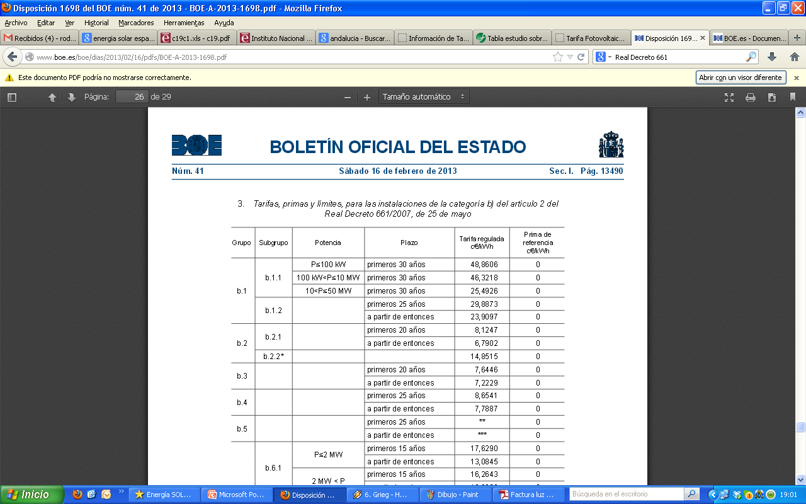
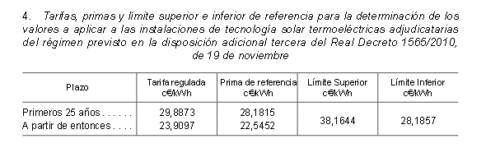

Slide 53

Growth forecast for thermo-solar energy in the Mediterranean basin.

Slide 54
EXECUTIVE SUMMARY
THE TECHNOLOGY
The need for energy consumption by man and its increase is a reality to which we must respond promptly with clean technologies like the JVR turbine. In Spain we only produce 30% of the energy we consume.
With this new technology we will be able to get a 3.5 times increase in energy production compared to the used nowadays (solar parables with Stirling engines and thermo-solar Towers), with the same investment, so we get a much greater efficiency for the same investment.
JVR technology is also capable of generating, desalinate and purify large quantities of water, a very important issue in countries where water is scarce.
All JVR technology patents are some already granted and others pending of the deadline for the grant.
This technology is able to supply this great need of energy and contribute greatly to supply the needs of water that certain countries can have.

Slide 55
INSTALLATION COSTS

Slide 56
1 Mw INSTALLATION COST
Product |  | Power in Mw/h | Number of units PARABLES | Price/unit | Price installed Mw/h
PARABLE |  | 1 | 67 | 30.000,00 € | 2.010.000,00 €
Sale price Kw/h, IET/221/2013 order, of 14 de febrero |  |  |  | INSTALLATION | Units | 1 Mw
 | Kw/h |  |  | Fuel tanks | 12000 | 12000
Regulated rate | 0,30 € |  |  | Civil works, installation and connection | 3000 | 201000
Average price Mw/h | 298,87 € |  |  | Fuel injectors | 300 | 20100
Generation with salts
20%
 | I.N.E. DATA
 |  |  | ANDALUCÍA – region of Spain with higher radiation
 |  |  |  | Average advantage
 |  |  | Average annual hours of sunshine | Anual in hours (+20%) | Hours percentage | Full days
 | Andalucía |  | 3000 | 3600 | 41% | 150
Installation amortization for 1 Mw
1 Mw/h installation | Number Mw/h |  | € | Amortization period in years
Cost | 1 |  | 2.243.100,00 €
Annual performance | 1 |  | 1.075.942,80 € | 2,08
1 parable installation | number Kw/h |  | € | Amortization period in years
Cost | 15 |  | 33.300,00 €
Annual performance | 15 |  | 16.139,14 € | 2,06

Slide 57

COMPARISON WITH OTHER INSTALLATIONS
This table obtained from a study for a 1 MW Photovoltaic installation by the Juan Carlos I University, shows the cost only of necessary equipment (the equivalent of buying the parables). To this must be added the rest of the installation costs, which adds
€ 4,849,257.03.

Slide 58
Generator with parabolic concentrator
July 2013
¿WOULD YOU BE INTERESTED?
jonas@jvr.es
We thank you

